Slide 1


H2020-MSCA-RISE-2015 ⎯ Grant Agreement N° 690835
Analysis of Local Monitor Signals
Muse Collaboration Meeting,
October 23, 2018
Nandita Raha, INFN Pisa

Slide 2
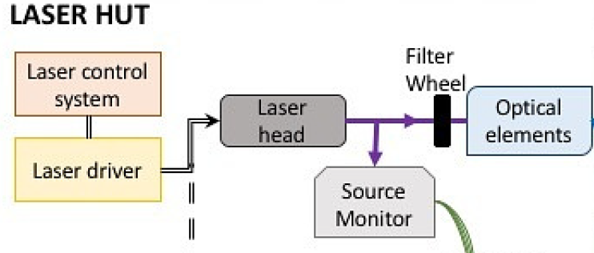
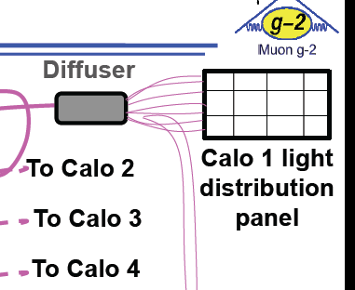
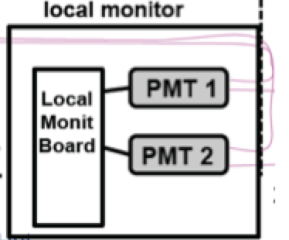
Laser System - Basics
x 6
SM: Monitors the laser source.

Slide 3
Old and New PMTs
Calorimeter | Old PMT | New PMT
11 | 25 | 5
12 | 26 | 0
13 | 27 | 6
18 | 28 | 8
20 | 29 | 4
Looking at calo 20 in detail – overall behaviour of all channels in back up. Since the amplitude is free from jitter of the pedestals, I used the amplitude instead of area for this presentation (though area plots are the same). Details of amplitude of first pulse here, as it will have the effect of temperature of the PMT alone.

Slide 4
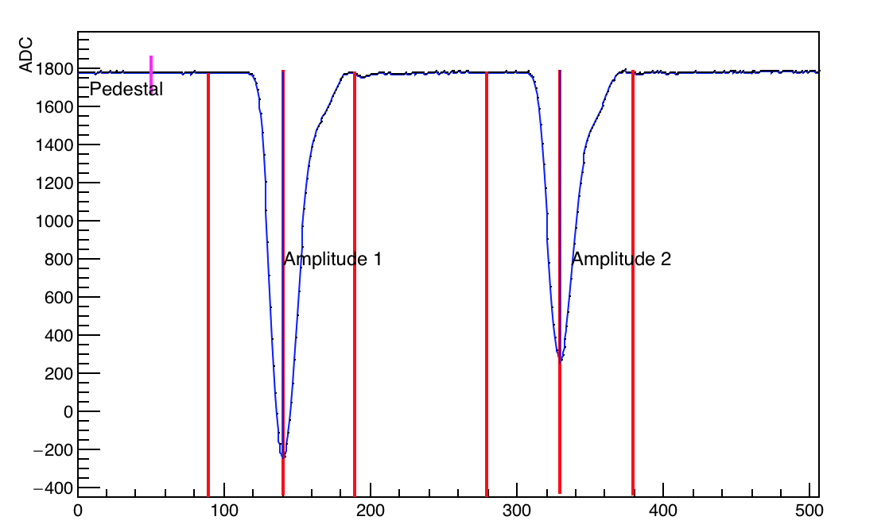
Parameter Definitions
Pedestal: Average first 50 samples
Amplitude: Pedestal subtracted peak sample
Area window: + 50 samples from peak.

Slide 5
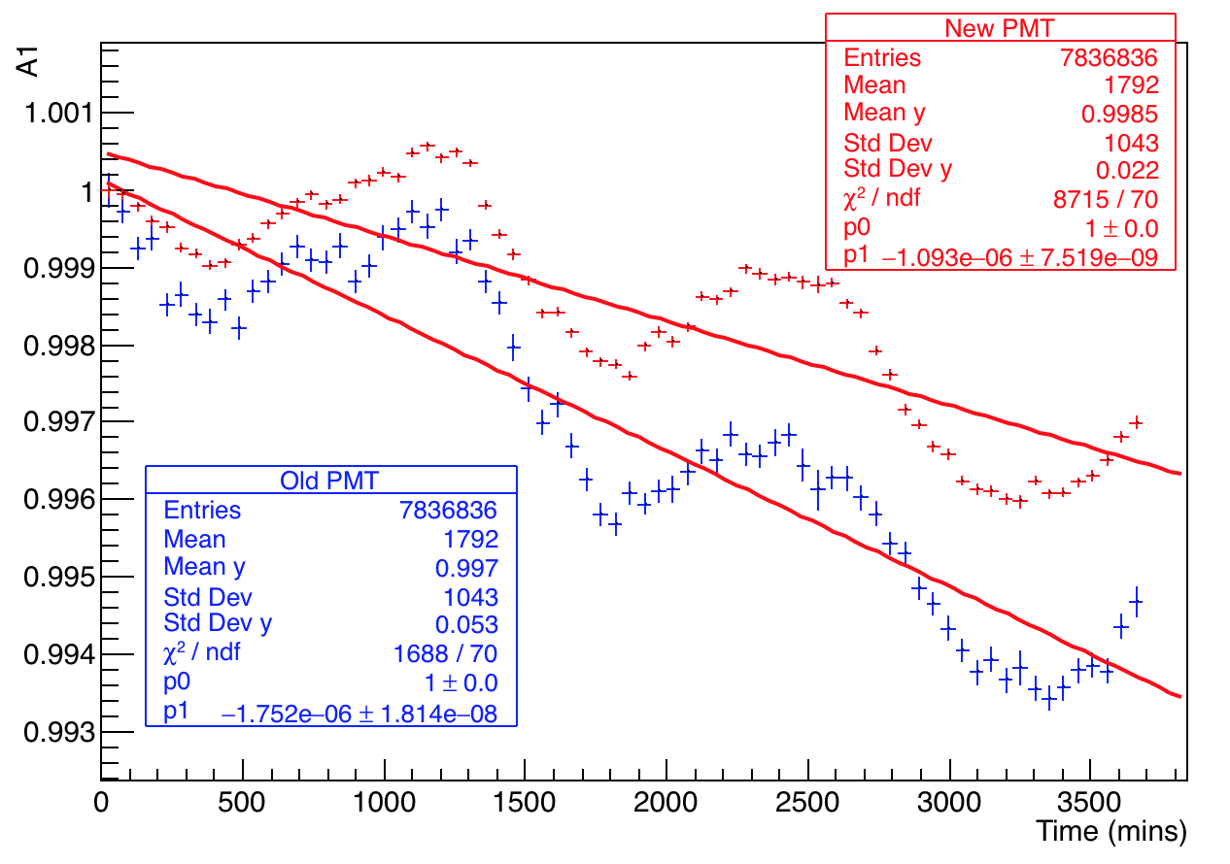
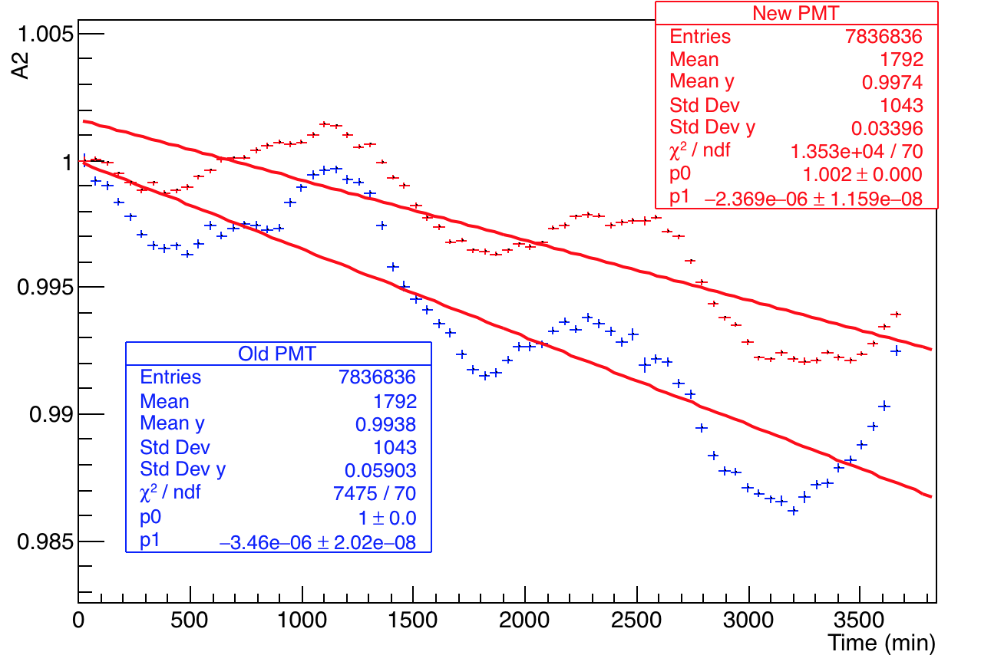
Comparison of old and new PMTs for Calo 20
Normalized area first pulse
Analysis based on 60 hour dataset
Normalized area second pulse
Old PMTs about 1.5 times greater drop than new ones

Slide 6
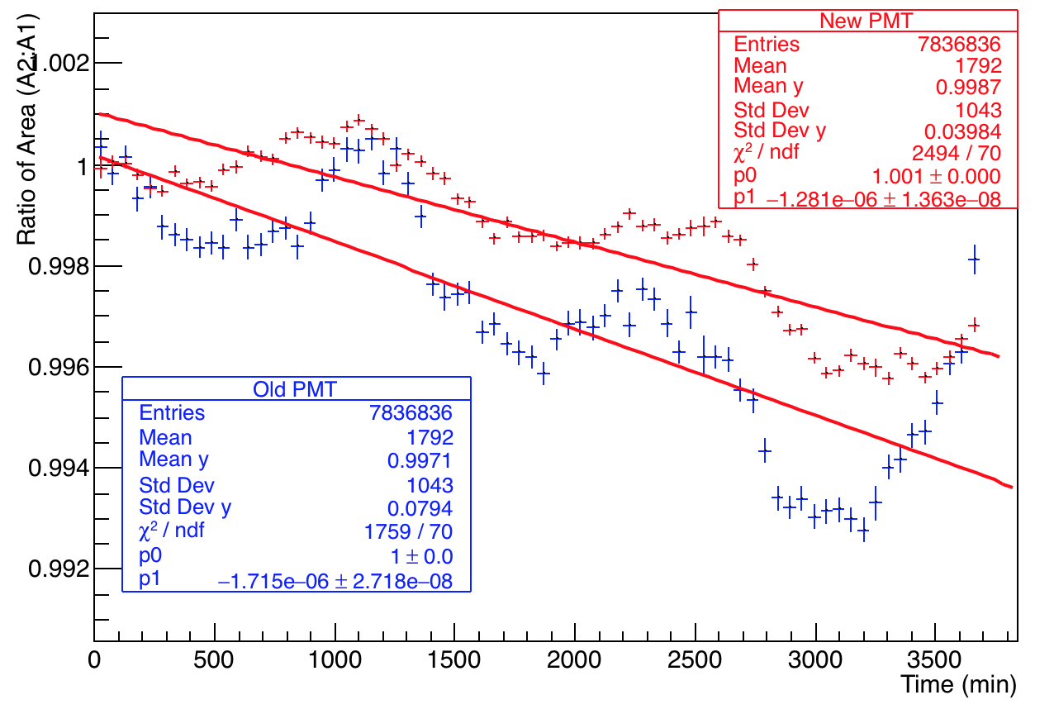
Comparison of old and new PMTs for Calo 20
New PMT – Calo 20, channel 4
Bin size = 50 mins.
Old PMT – Calo 20, channel 29

Slide 7
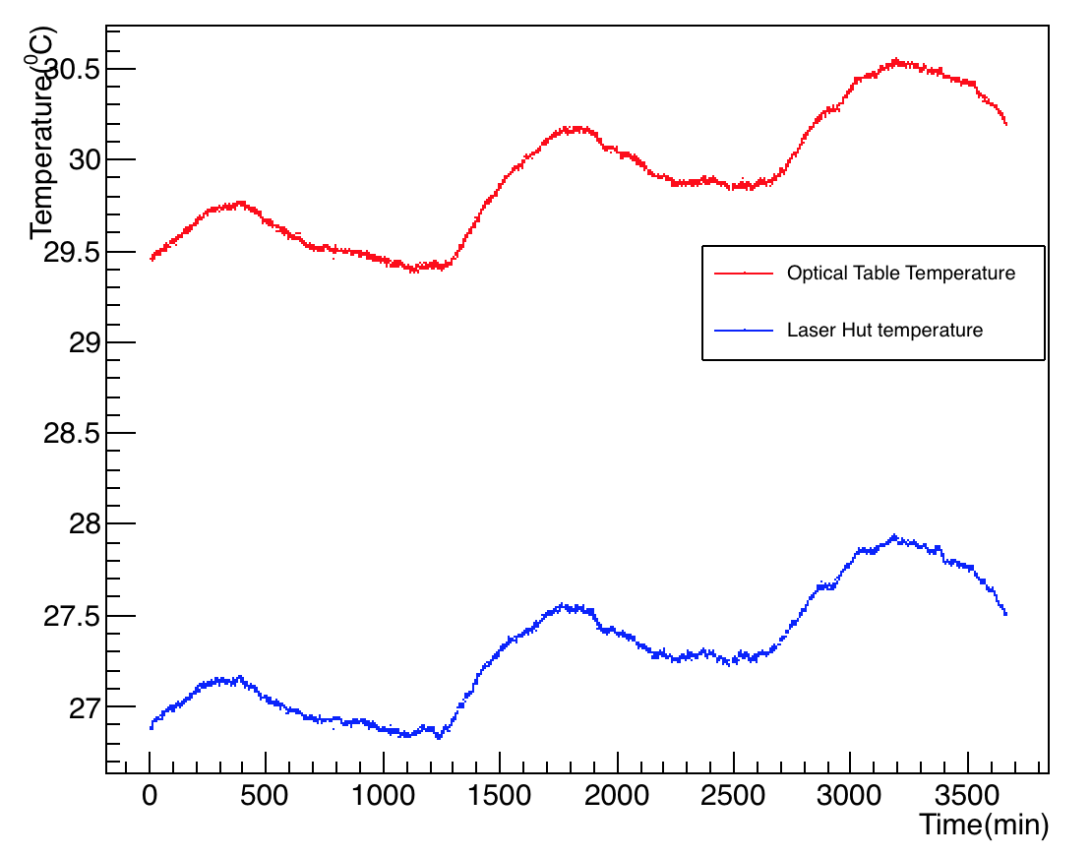
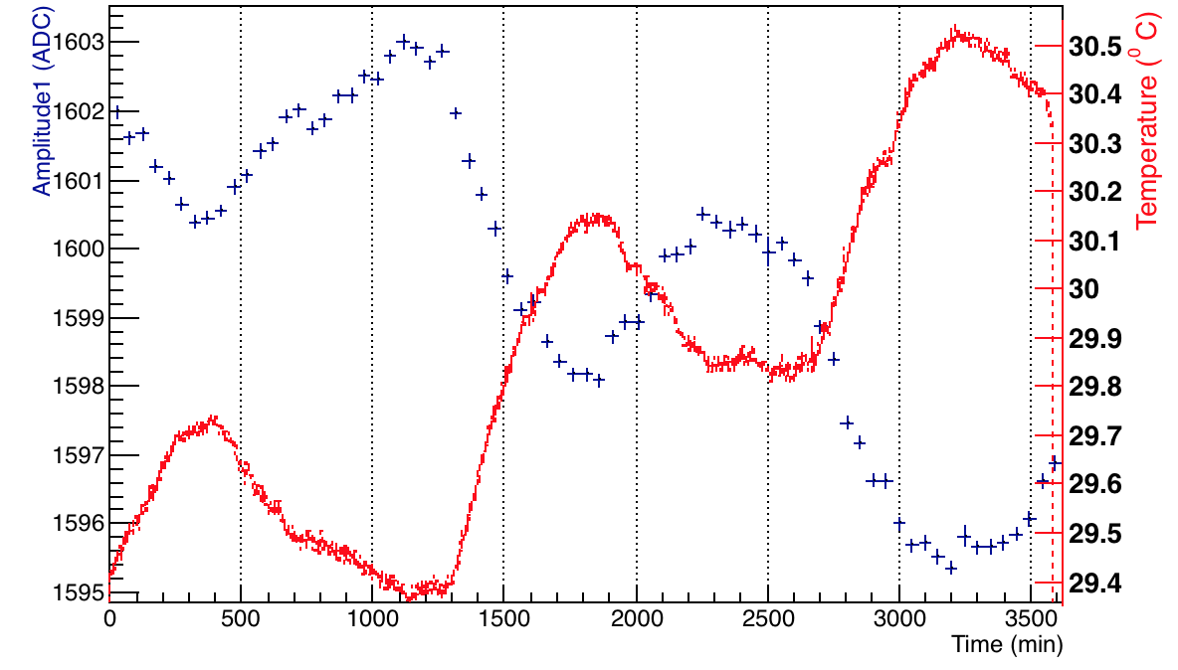
Temperature Variation – Channel 4
Optical table temperature
Overlaid temperature and A1 on the same plot
Laser hut temperature
Note: Bottom plot clearly shows a negative temp coefficient

Slide 8
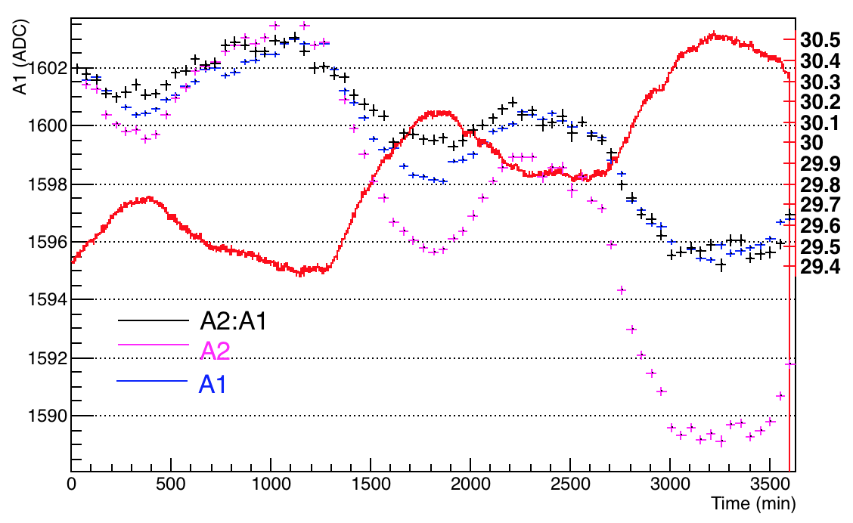
Temperature Variation – Channel 4
Overlaid temperature and A1, A2 and A2:A1 on the same plot, after normalizing all to A1 for consistency
Optical table temperature

Slide 9
Amplitude Vs. Temp – Channel 4
A linear fit on the temperature Vs. amplitude plots – gives the approx. gain drop / ºC

Slide 10
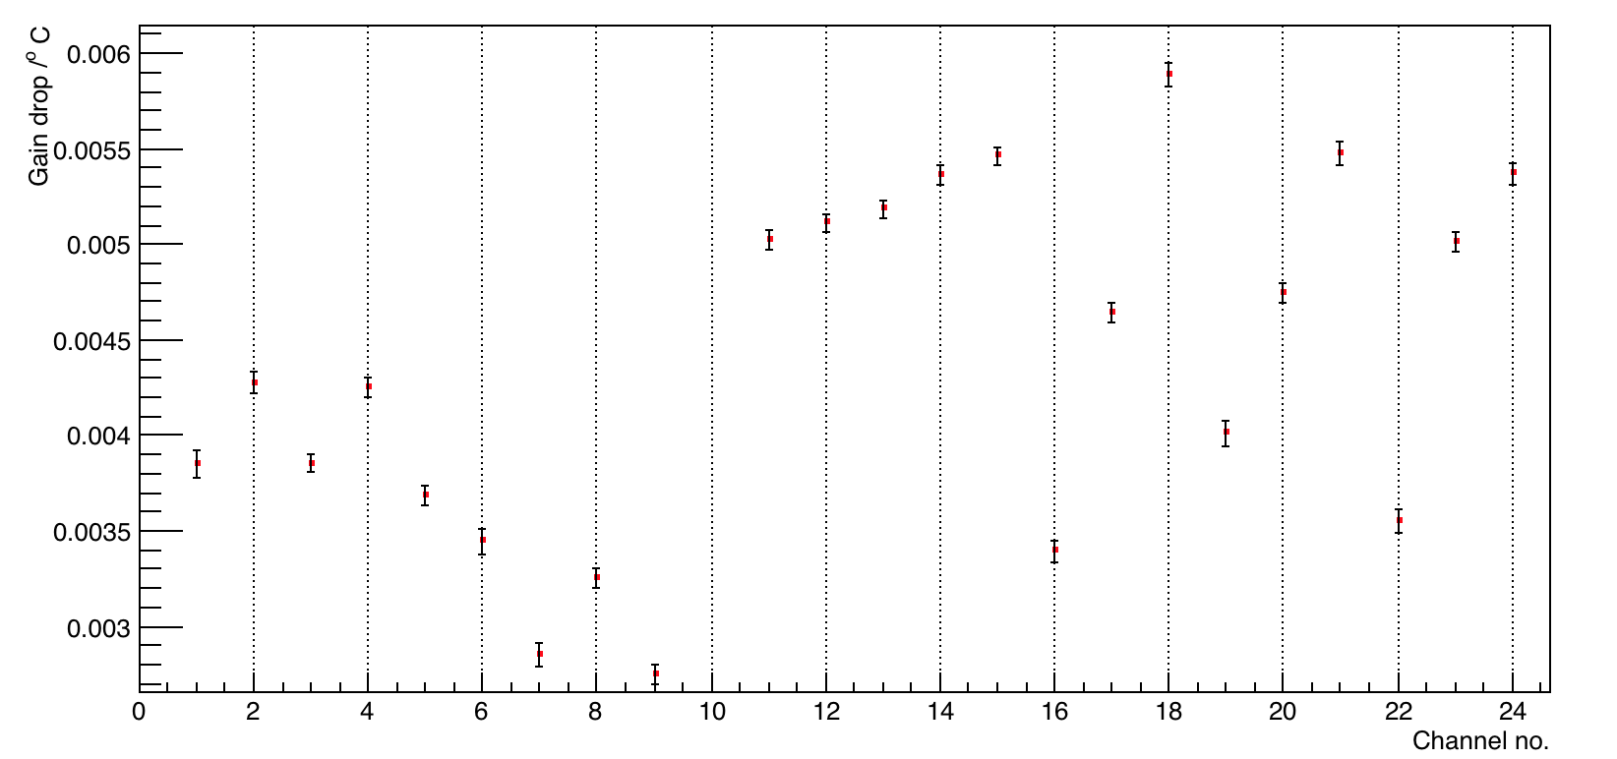
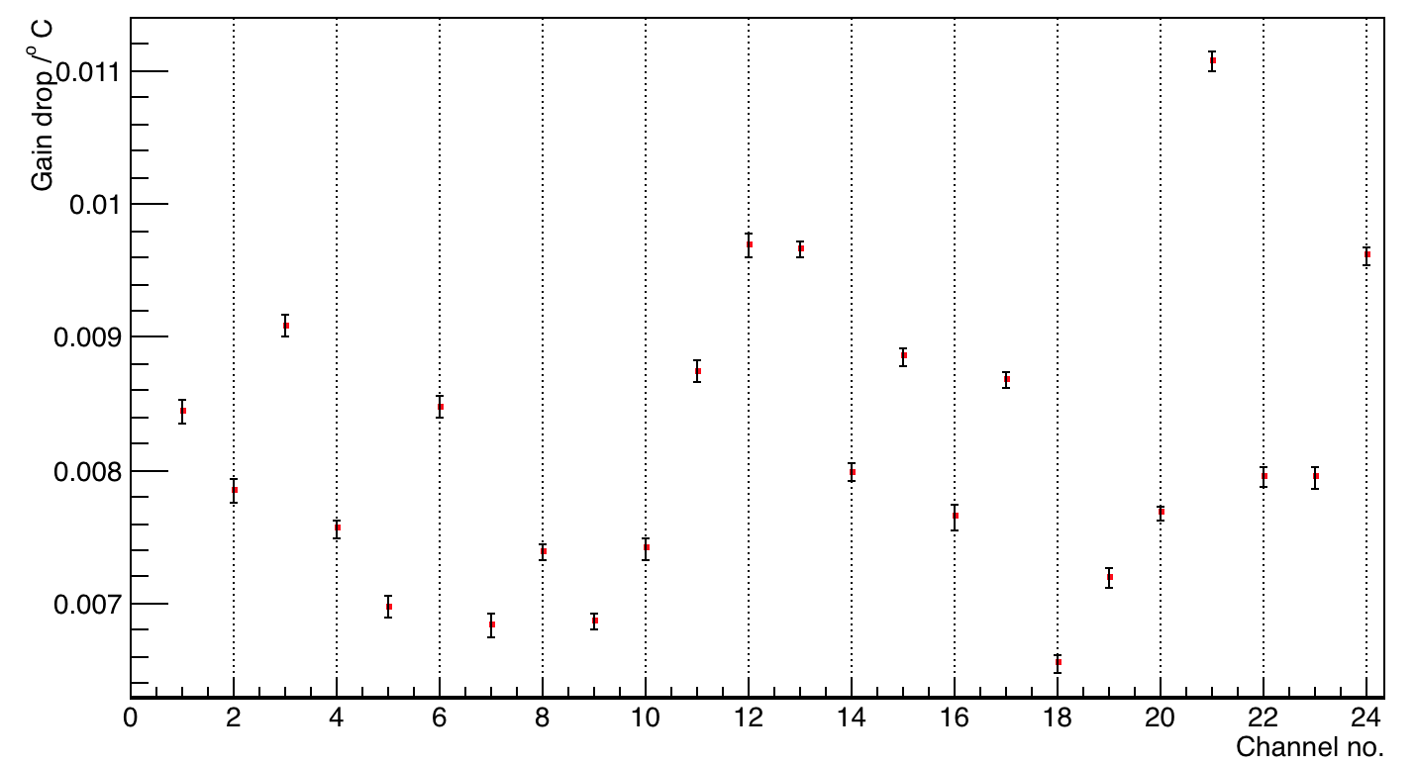
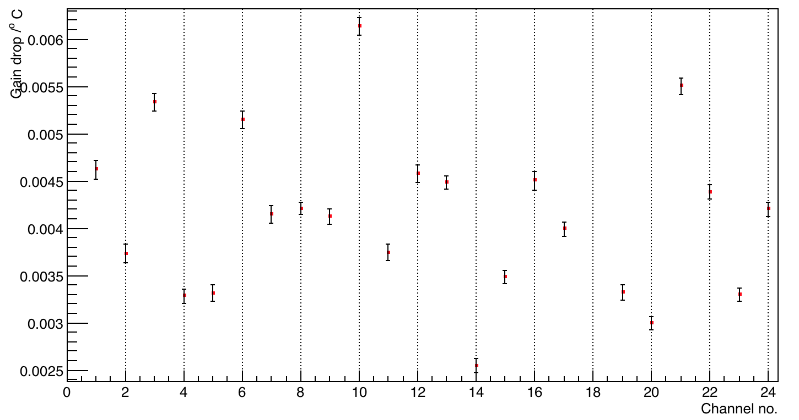
Amplitude Vs. Temp – all channels
Amp 1
Amp 2
A linear fit on the temperature Vs. amplitude plots – gives the approx. gain drop / ºC for every channel (or calorimeter)
A2:A1

Slide 11
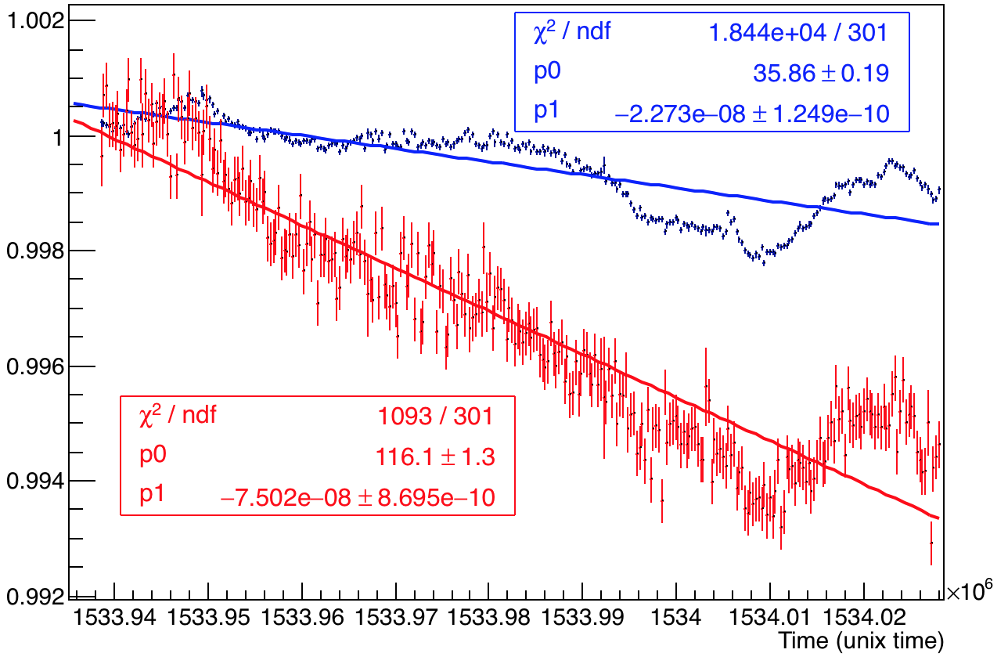
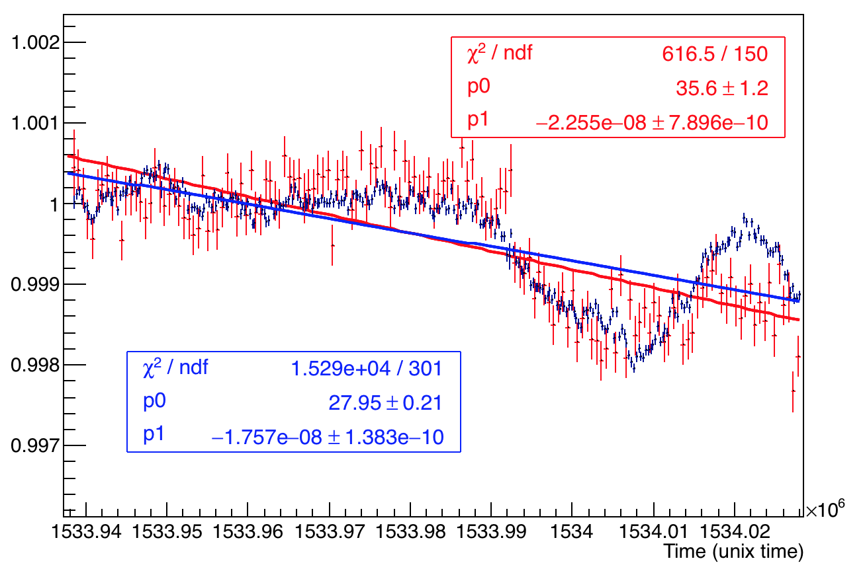
Comparing A1 and A2 – a special run 18413
A1
A2
PMMA Channel 23
A2
Run 18413 – 24 hours
Normalized by the mean of first 5 bins
A1
Silica Channel 24

Slide 12
Conclusions
A1 primarily indicates the gain fluctuation of the PMT, as it is directly connected to the PMT from SM. As expected we have a negative correlation with temperature (PMT gain). A1 is similar for channels 23 and 24 does not depend on the type of fiber used.
A2 can have additional effects in fluctuation due to forward and reverse fibers to and from the calorimeters respectively.
For silica no visible effects on A2.
For PMMA "strange" and significant drop behind Gain variation – maybe attributed due to heating effect of temperature.
In any case LM correction is not necessary – the long term out of fill effects due to environmental factors do not effect the short term in fill SiPM gain function.

Slide 13
Back Up Slides

Slide 14
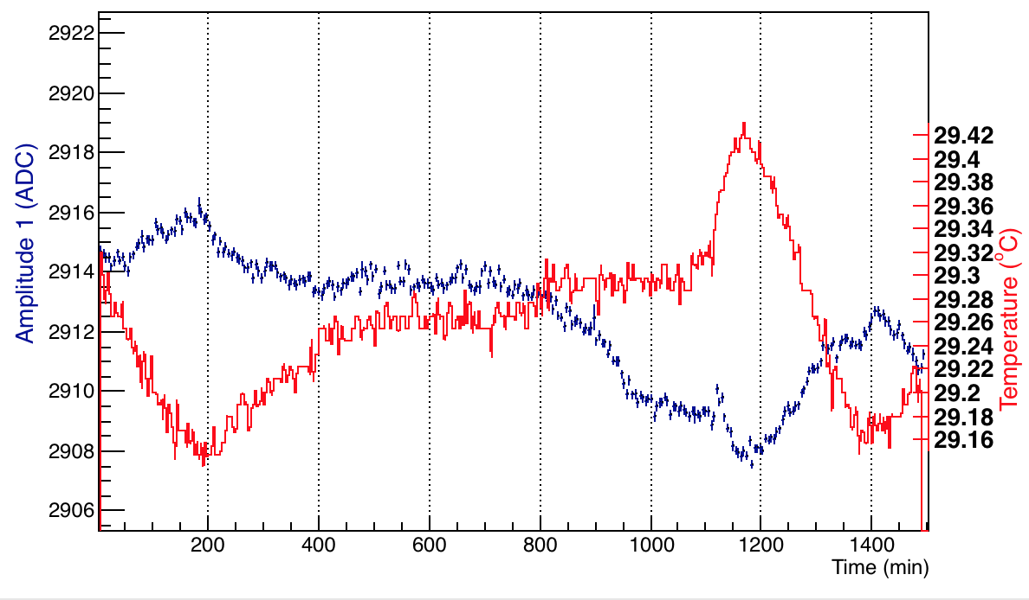
Temp dependence on A1 – Channel 23
Channel 23, Amplitude 1
Run 18413

Slide 15
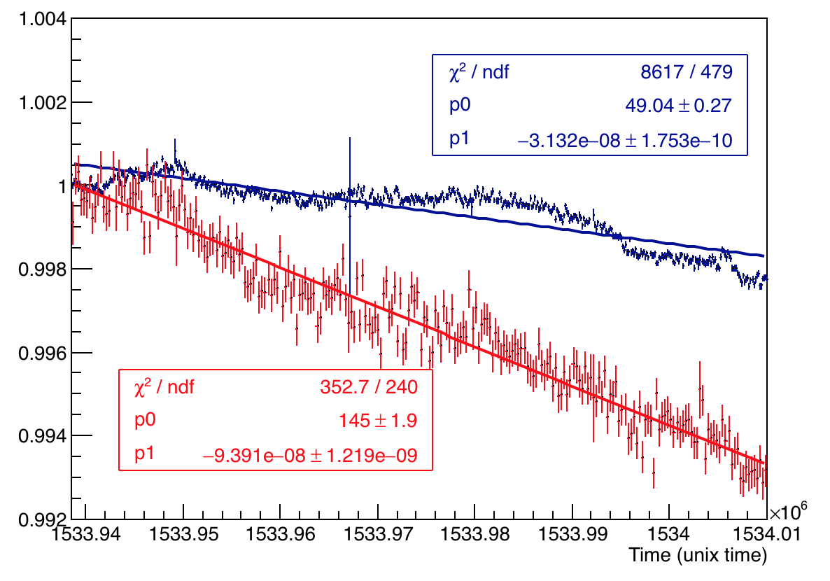
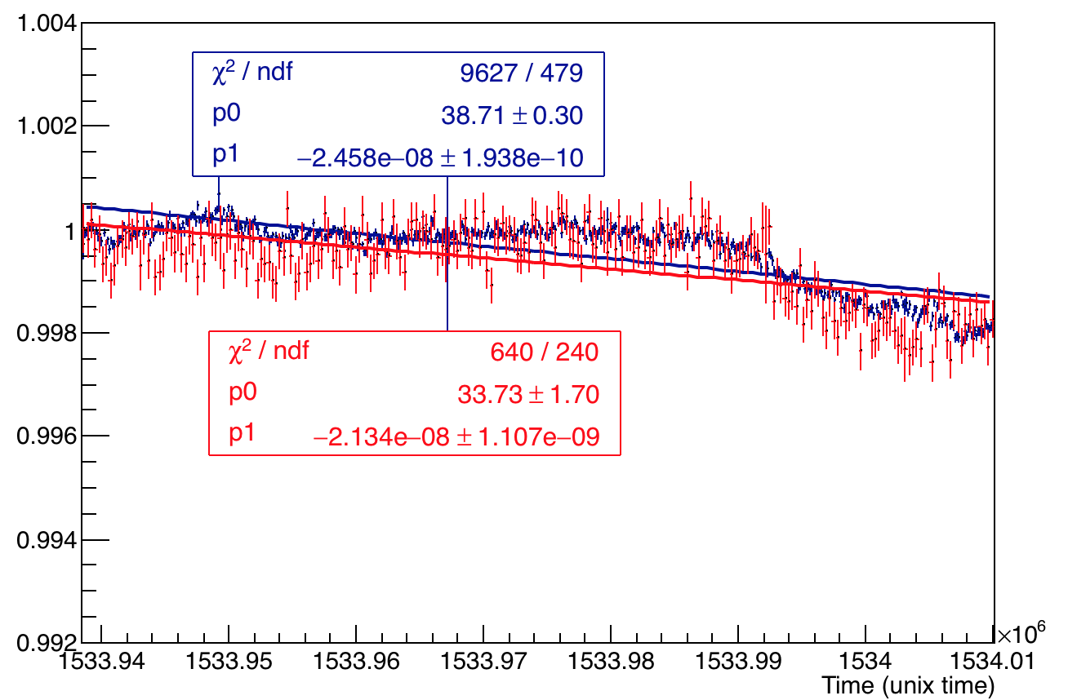
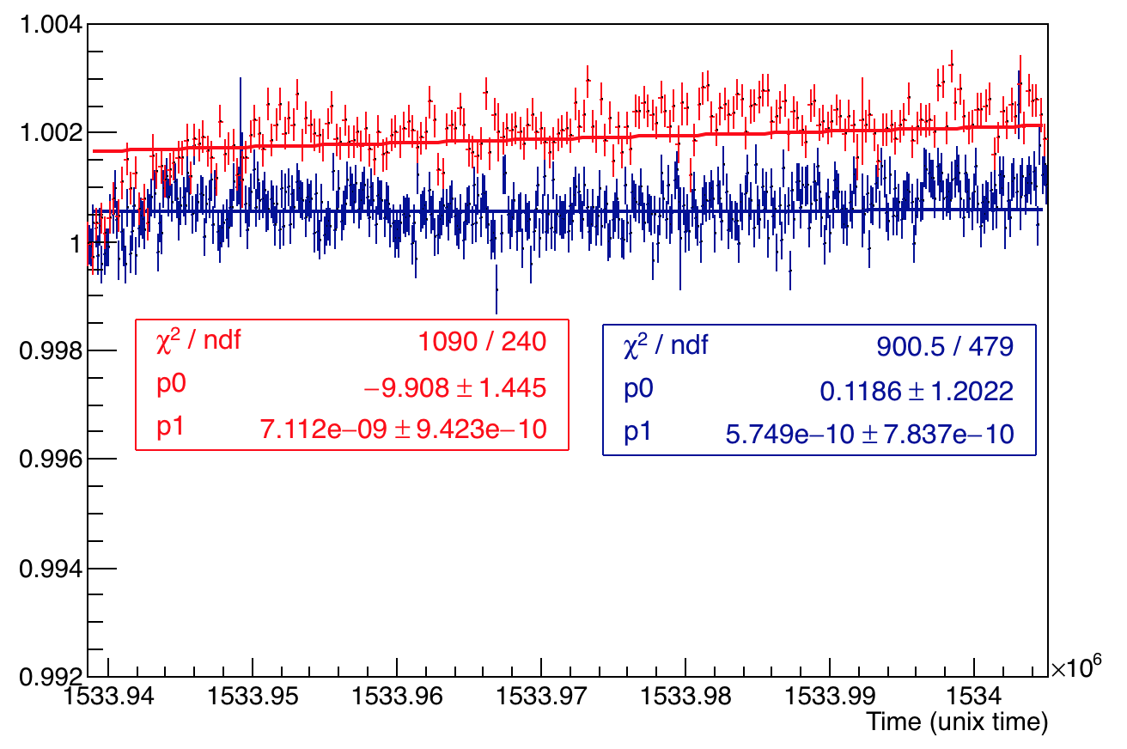
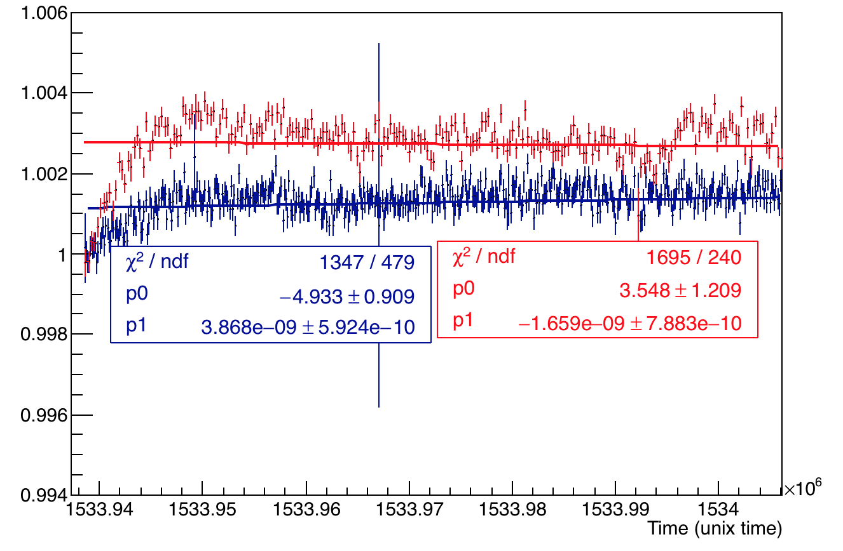
Checking all channels A1 and A2 overlaid – other run
PMMA Channel 23
Silica Channel 24
Channel 0
Channel 1

Slide 16
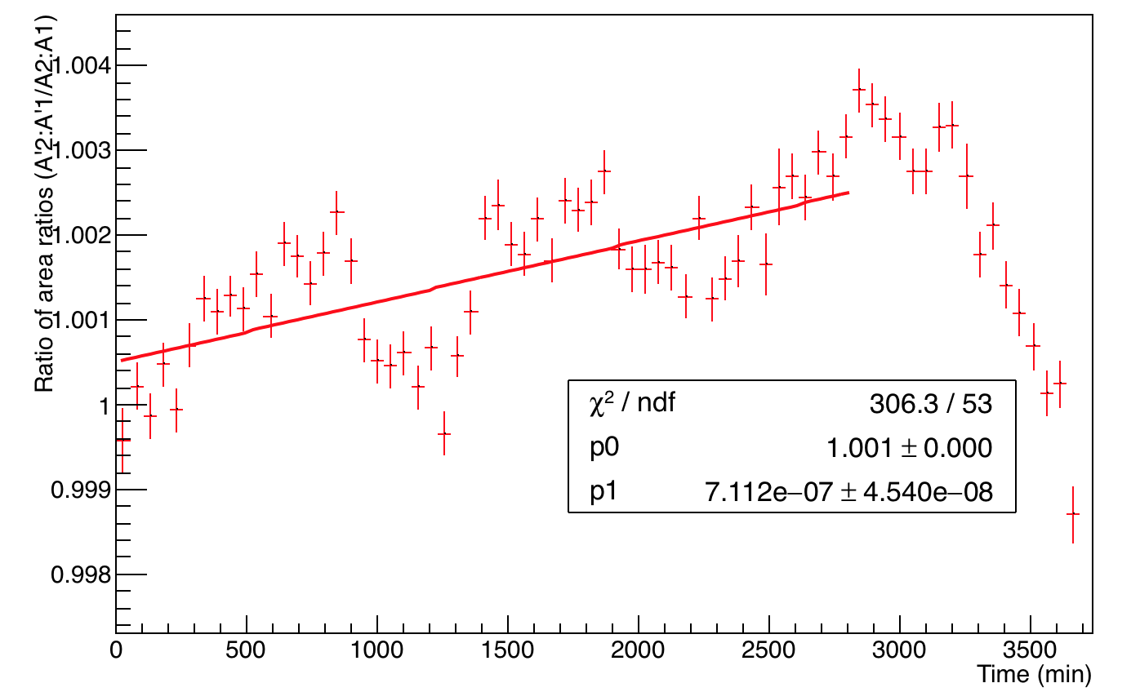
Ratio of ratios for Calo 20
R = A2:A1 of new PMT and R’ = A’2:A’1 of old PMT. The ratio of these ratios R: R’ (new:old) is slightly unstable => The “return” component is not stable.
Fitted with p1 just to get a rough idea of the drop in ratio of ratio’s per min. This is 7e-7/min for calo 20

Slide 17
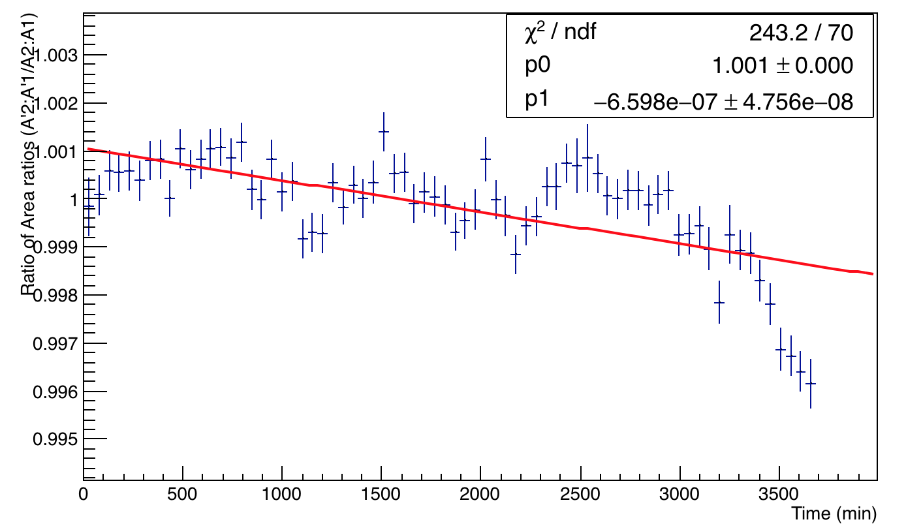
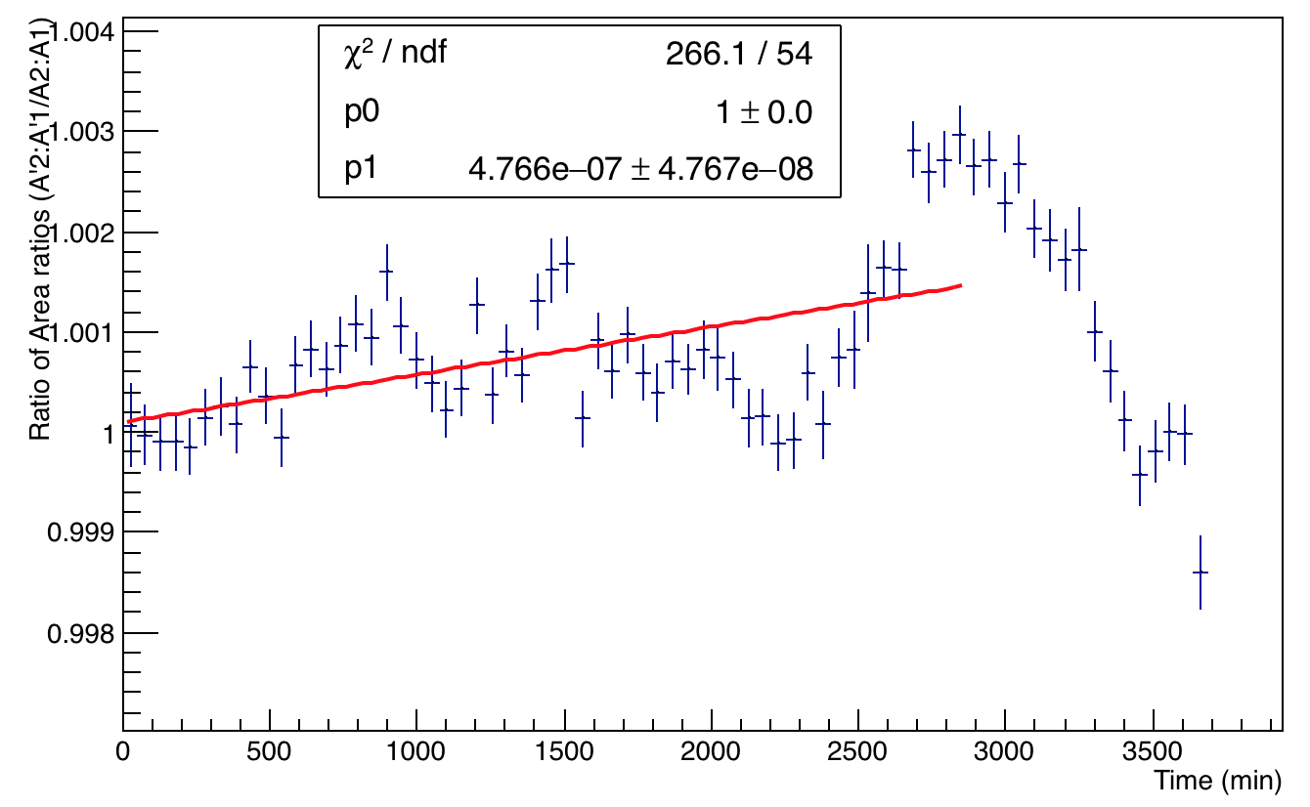
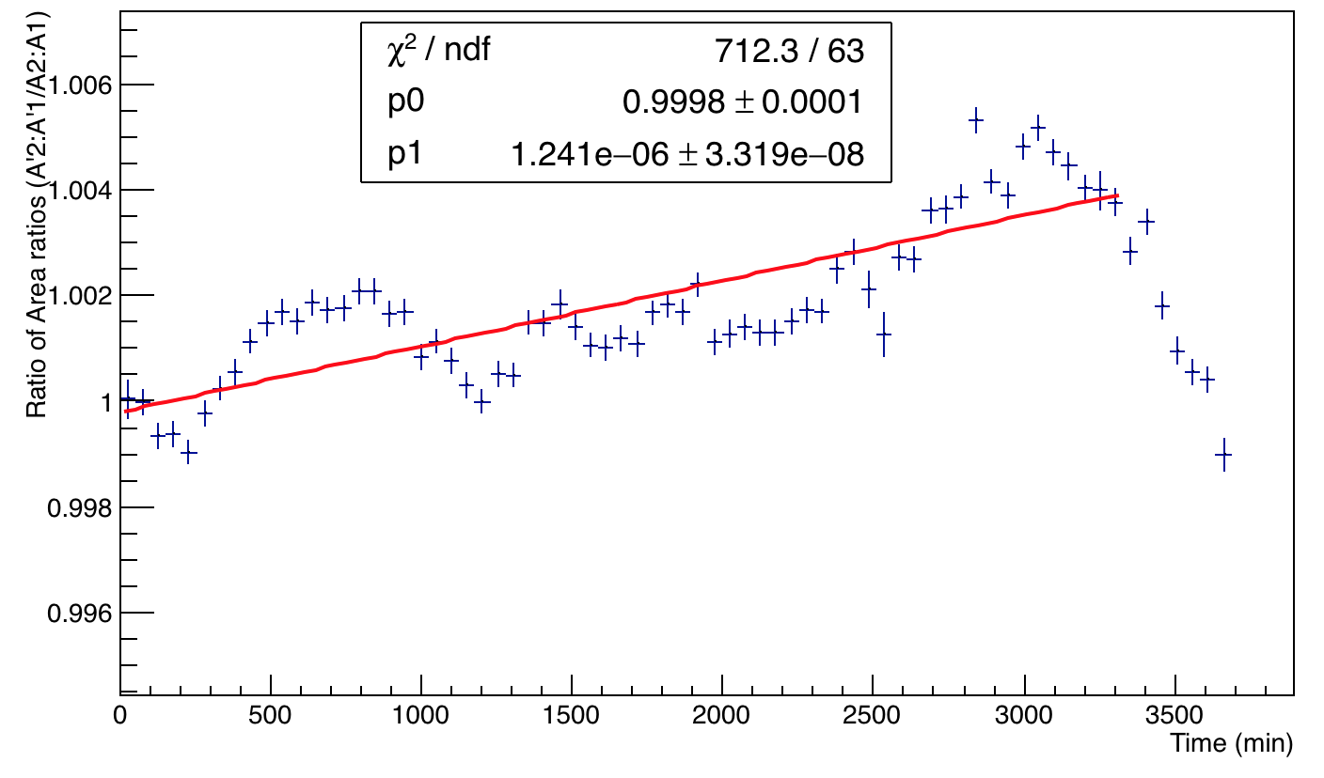
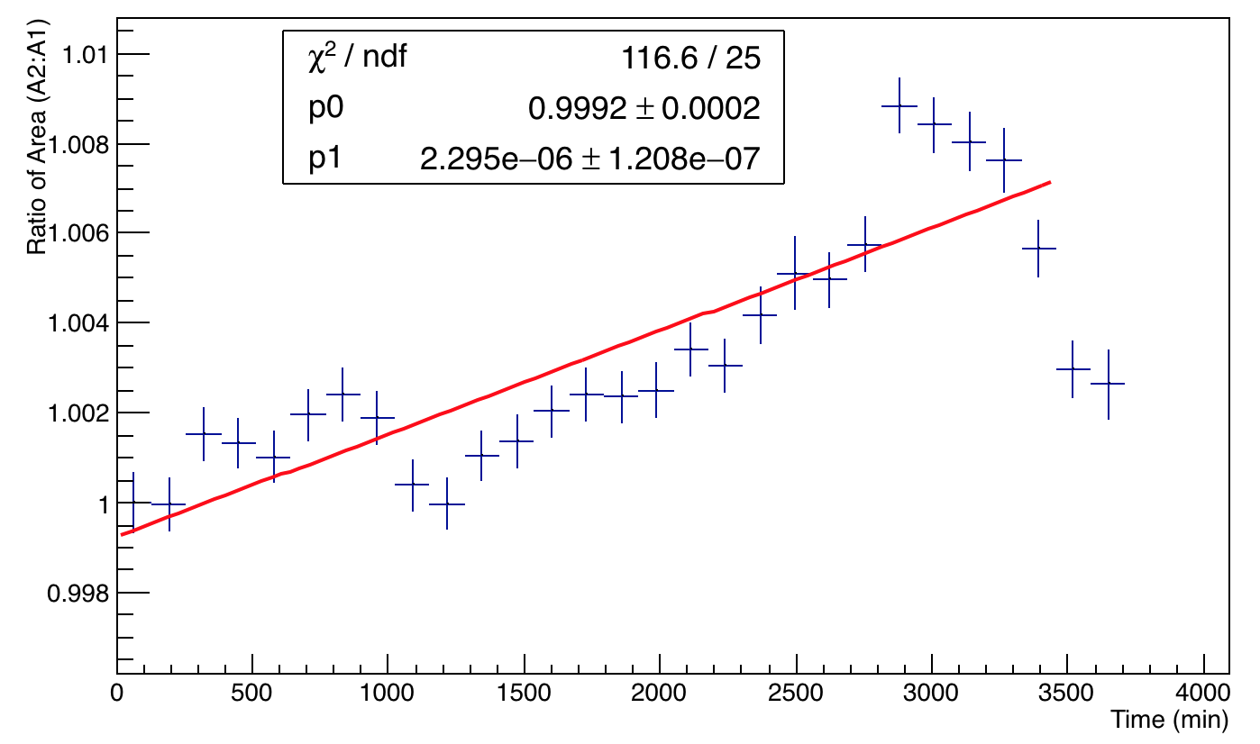
Ratio of ratios other calos
Calo 11
Calo 12
Calo 13
Calo 18

Slide 18
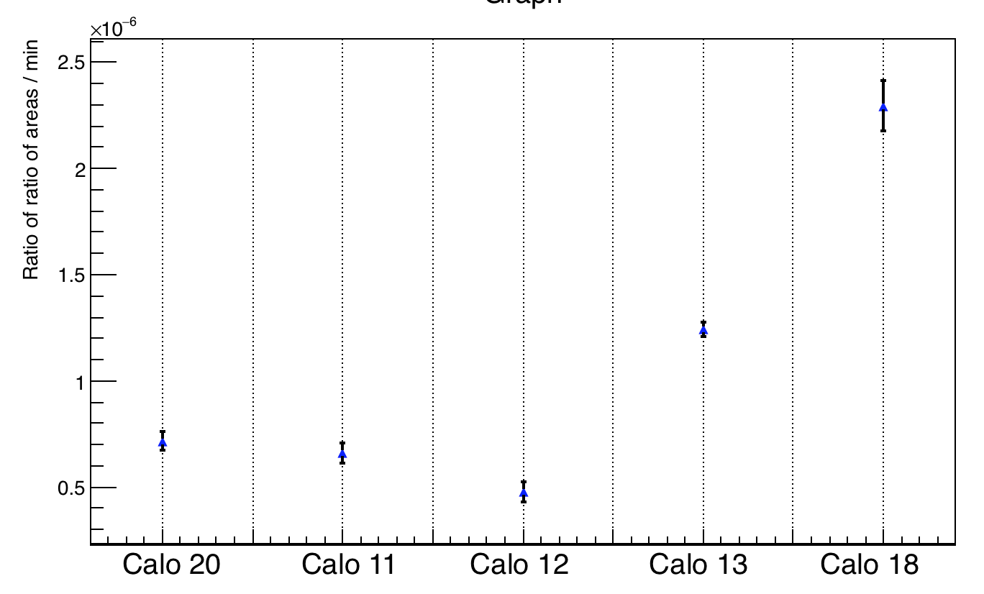
Variation Ratio of ratios/min
Mostly, the drop is of the order of ~10⁻⁷/min

Slide 19
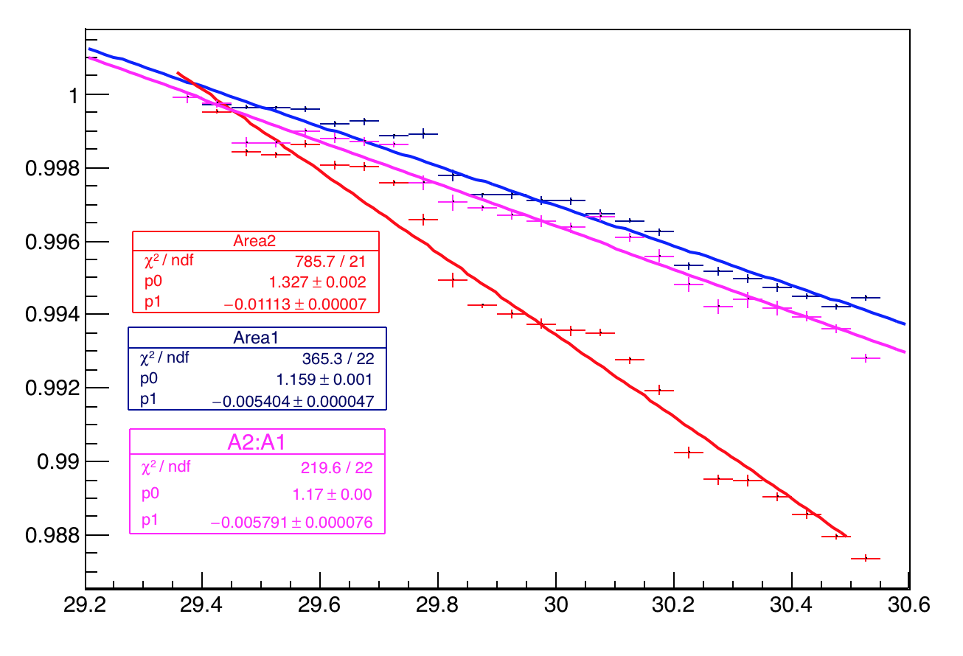
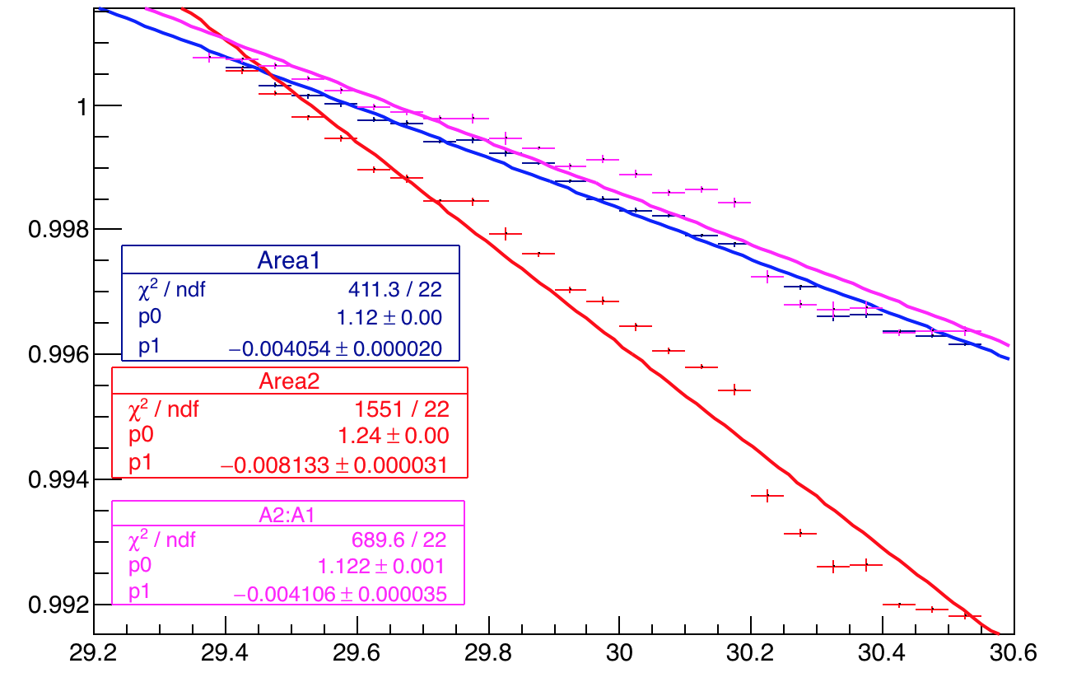
Recap - Temperature variation calo 20
Reminding the temp variations of A1, A2 and A2:A1 for channel 29 and 4– old PMT of calo 20.
Channel 29
Channel 4

Slide 20
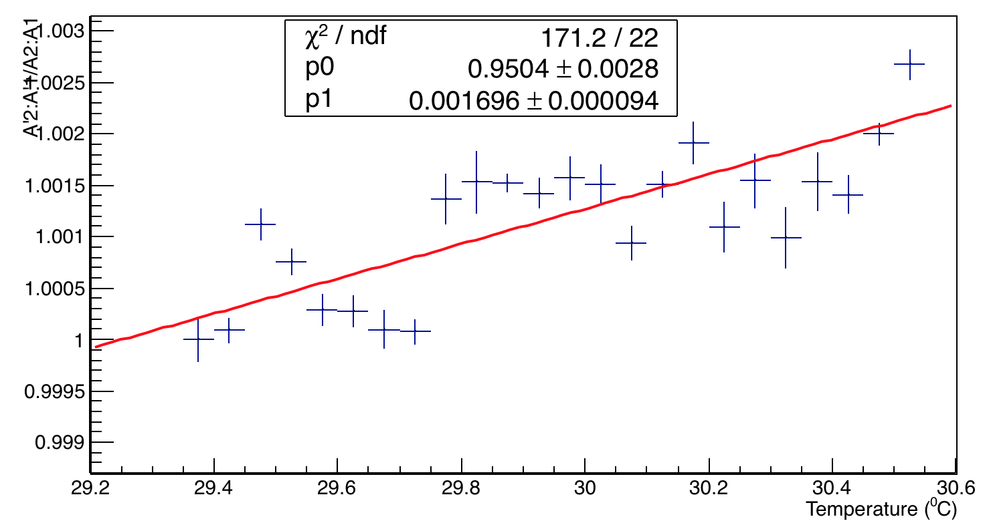
Temperature variation of Ratio of ratios- ch 20
This is to check the variation of any drift of the return signal from the calorimeters with temperature for this dataset.
Change is 0.16% / ⁰C

Slide 21
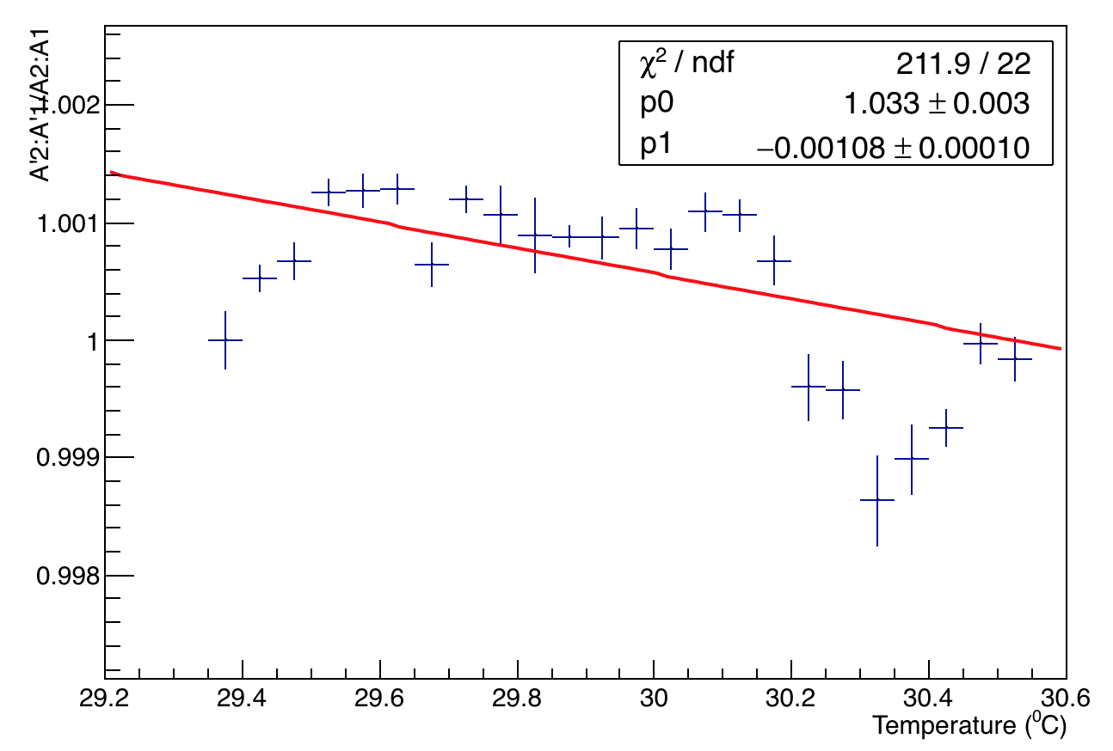
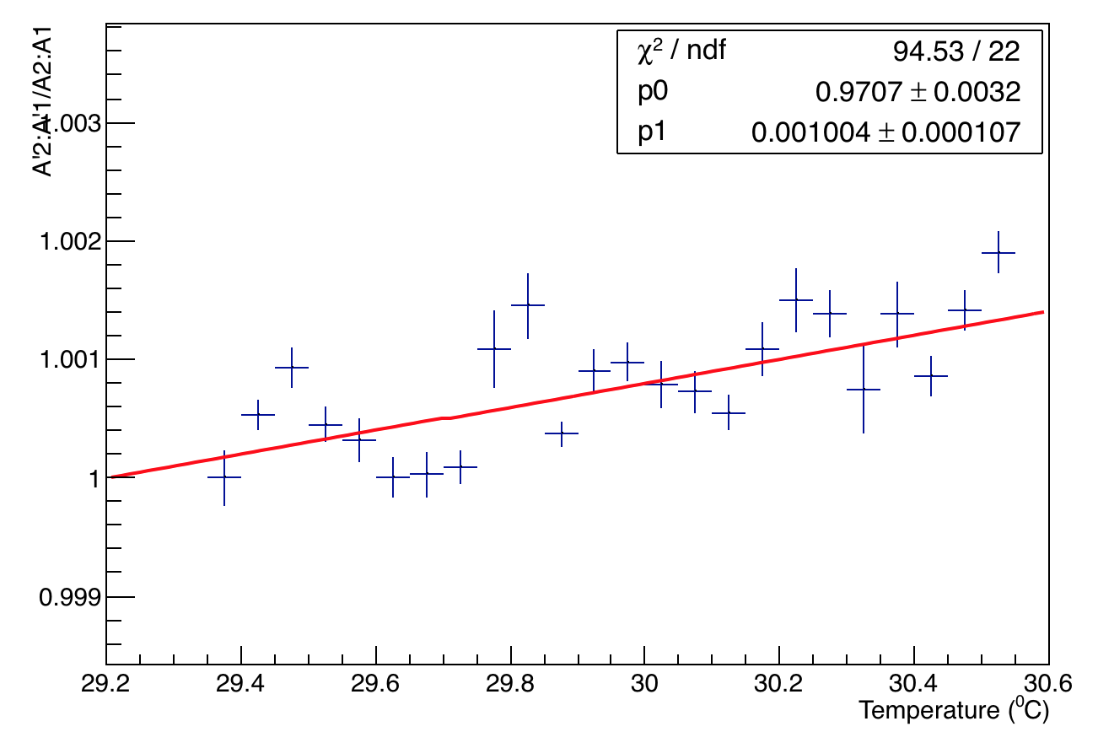
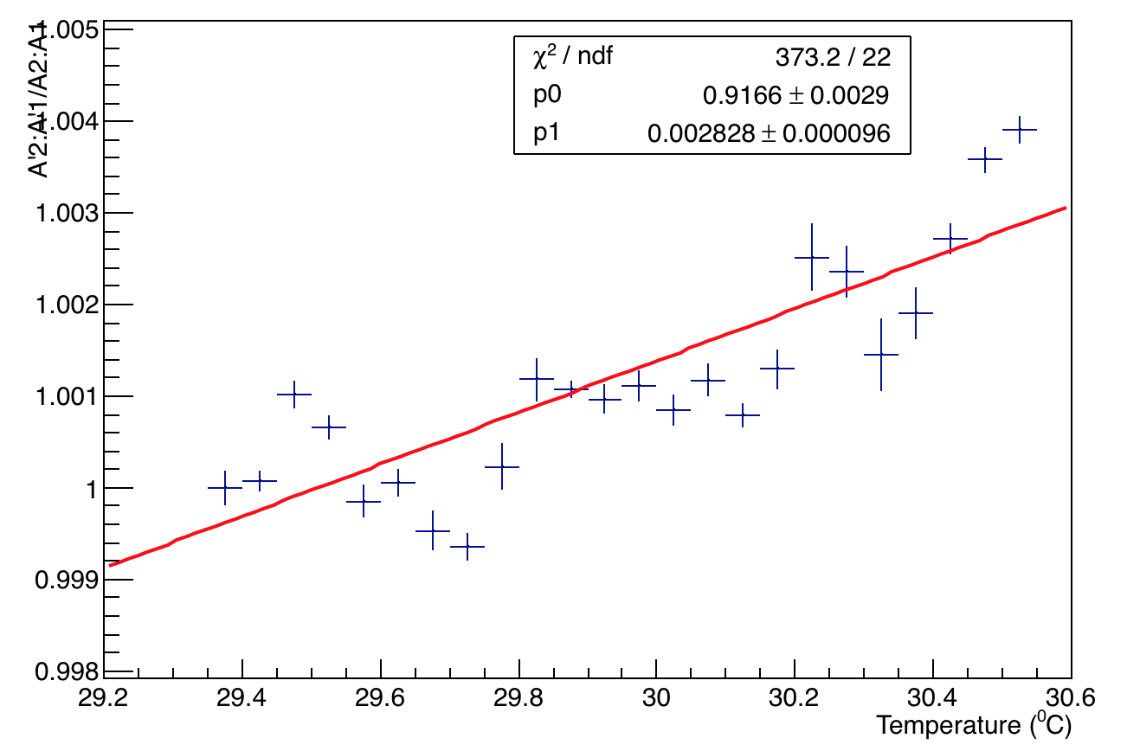
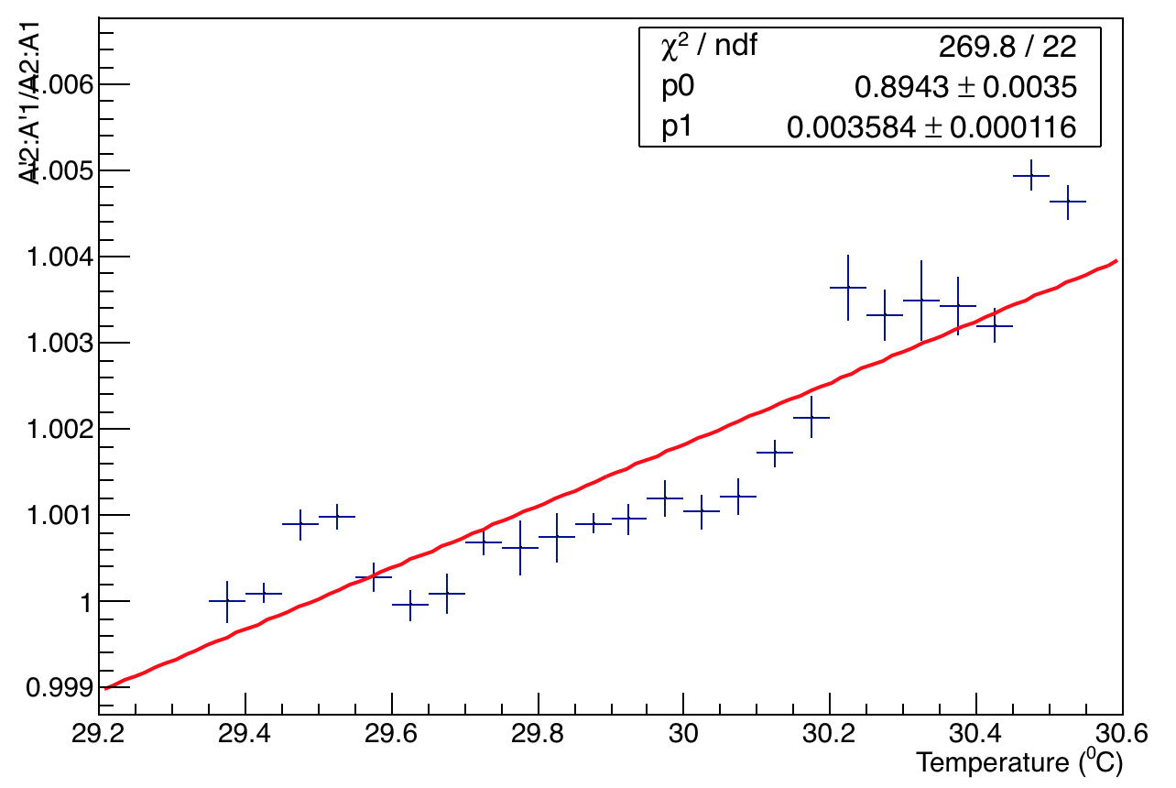
Temperature Vs. Ratio of ratios other calos
Calo 11
Calo 12
Calo 18
Calo 13

